Slide 1
Global Volatility and Firm-Level Capital Flows
Marcin Kacperczyk (Imperial College)
Jaromir Nosal (Boston College)
Tianyu Wang (Tsinghua University)
EFA, August 2022

Slide 2
International Portfolio Flows
Stock market volatility and international portfolio flows
important consequences for financial stability
capital flow regulation
Empirical evidence on international capital flows
significant foreign capital retrenchment in times of market stress
based on aggregate outcomes (country/market)
useful to isolate common factors in the data (push and pull)
Albuquerque, Bauer, Schneider (2007, 2009), Coeurdacier & Rey (2013), Caballero & Simsek (2021), Broner, Didier, Erce & Schmukler (2013), Rothenberg & Warnock (2011), Avdjiev, Hardy, Kalemli-Ozcan & Serven (2018), Forbes & Warnock (2012), many others

Slide 3
International Portfolio Flows
Aggregate analysis assumes homogenous investor behavior. Issues:
Stock/investor selection/heterogeneity; static and time-varying
Endogenous investor responses vs. exogenous flows/constraints
Stock-specific vs. average responses
Want to understand individual investors’ incentives (discretionary trades)
helps point to potential economic mechanisms
sudden stops, fickle capital, aggregate vs. idiosyncratic discretionary responses
affects the framework for policy and crises management
Implications for policy related to capital flow regulation. Equivalent regulation?
investor type-specific $\underset{⇔}{?}$ stock level $\underset{⇔}{?}$ aggregate flows
Need: disaggregated analysis

Slide 4
Data
Use firm/investor-level panel evidence on equity allocations globally [Thomson Reuters/Refinitiv Datastream]
Focus on variation in global (aggregate) volatility GVOL
Quarterly, based on MSCI ACWI global index
Have alternatives: GFC+COVID
20k+ firms, 40k+ investor portfolios, years 2000-2020
Main outcome variable: log changes in institutional portfolio shares
At the firm/institution level
Distinguish between domestic (DOM) and foreign ownership (FOR)
Developed vs emerging markets
Unit of observation: i (firm), j (institution), t (quarter)

Slide 5
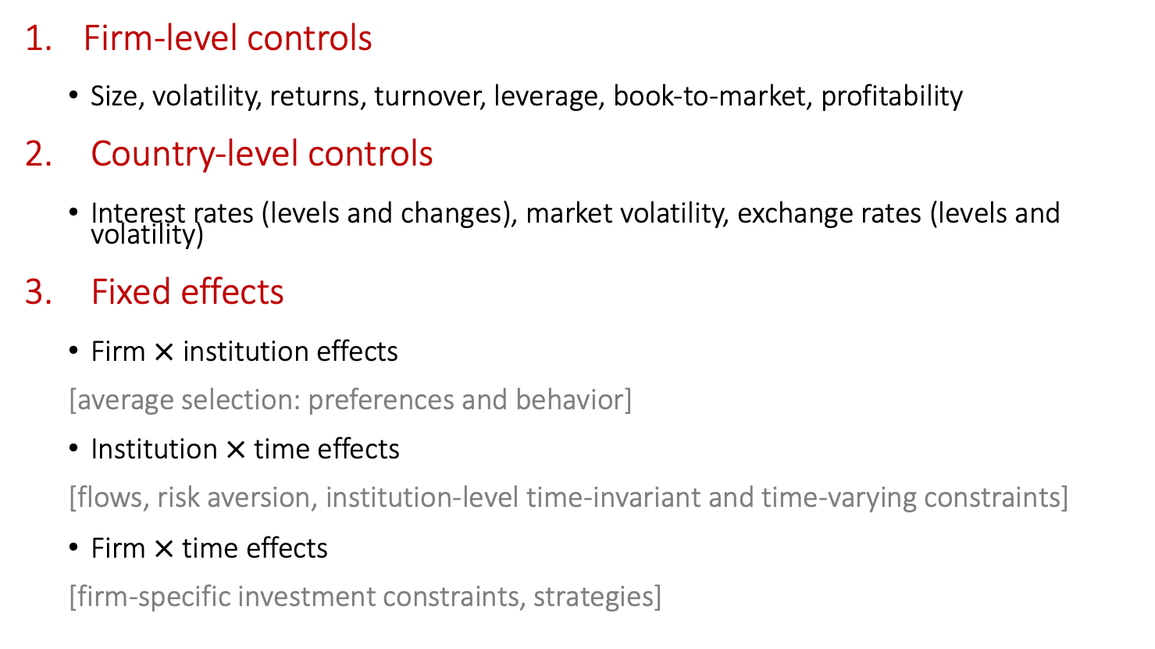
Controls
Firm-level controls
Size, volatility, returns, turnover, leverage, book-to-market, profitability
Country-level controls
Interest rates (levels and changes), market volatility, exchange rates (levels and volatility)
Fixed effects
Firm $×$ institution effects
[average selection: preferences and behavior]
Institution $×$time effects
[flows, risk aversion, institution-level time-invariant and time-varying constraints]
Firm $×$time effects
[firm-specific investment constraints, strategies]

Slide 6
Three Main Questions
Does (dis)aggregation matter? Yes.
Firm-level aggregate response
2.2 pp drop in firm ownership flows per one-standard-deviation increase in Gvol
1.8 pp Developed, 2.5 pp Emerging
Does this capture average institution’s behavior?
Firm-investor-level response
3.6 pp drop in firm ownership flows per one-standard-deviation increase in Gvol
$controlling for firm × investor FE:$doubles to 8.6 pp
aggregation and selection

Slide 7
Three Main Questions
Does (dis)aggregation matter? Yes.
Theory+evidence points to significance of foreign flows
${FOR}_{i,j,t}$: equal to one if institution j is a foreign owner of stock i
Foreign investors amplify firm-level outflows
by a roughly 40-50% relative to domestic investors
Significant only if we control for time-varying fund characteristics
time-varying fund flows and/or investor-level constraints
heterogeneity in dynamic unobservables at the fund level
additional 8.2 pp drop in flows
Extreme uncertainty (GFC+Covid): amplified response, esp. Emerging Markets

Slide 8
Three Main Questions
What is the mechanism behind individual investors’ responses?
Build an equilibrium model of information and portfolio choice: micro-foundation of the capital flow movements
Key ingredients
investor heterogeneity: information
asset heterogeneity: size and volatility
Exploit predictions for the cross-section of assets by market cap
separate mechanisms based on aggregate fund shocks [risk aversion] and endogenous asymmetric information [learning-trading adjustment]
global volatility shock/foreign risk aversion shock
relocation towards large cap
only if information choice is endogenous
Prediction confirmed in the data: analogous relocation, stronger for foreign investors
small market cap stocks see outflows relative to large stocks
one standard dev. of size reduces outflows by 30%-50%
in model: better informed [data: Kacperczyk, Sundaresan, Wang (2021)]

Slide 9
Three Main Questions
Do flows matter for stability? Yes.
1Q and cumulative 1Q-4Q
volatility of stock returns
liquidity: stock turnover
Consequences for stability
volatility mitigated by institutional ownership flows, esp. in high vol times
liquidity improved by institutional ownership flows in all periods
differential effect across assets due to differential response of flows across market cap
$⟹$ retrenchment after global shock destabilizes stocks
$⟹$ heterogeneous across stocks: large versus small
Emerging versus Developed:
Vol effects mostly in developed, liquidity effects mostly in emerging

Slide 10
Extensions and Robustness
Extensive margin: entry and exit
overall consistent with combined effect
in cross section, foreign entry into large stocks strongest
Importance of US: excluding foreign investors preserves results
Tax havens
excluding markets or firms does not significantly affect results
Developed vs Emerging Markets
Developed: qualitatively & quantitatively similar to aggregates
Emerging: larger magnitudes & less statistical power
Covid+GFC
all effects much stronger, especially for Emerging Markets

Slide 11
Conclusions
In globally connected markets capital flows play an important role
concern that foreign flows are uniformly destabilizing local markets
Foreign investors
react more negatively to volatility shocks
discriminate between information-sensitive and information-insensitive assets
flows can have asymmetric effect on firm stability in bad times
Strength of response
aggregate effects are largely biased downwards
discretionary decisions make flows more sensitive than regulation (inelastic markets)
Risk aversion important determinant of capital movements
our results: also driven by endogenous information choices
Implications for policy related to capital flow regulation. Equivalent regulation?
investor type-specific $\underset{⇔}{?}$ stock level $\underset{⇔}{?}$ aggregate flows

